Slide 1
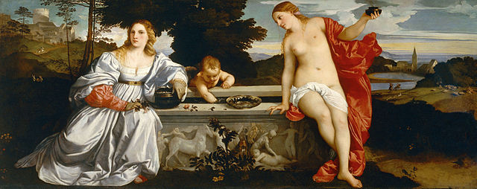
History 336
Ideas and Society in Early Modern Europe:
The Debate about Gender and Identity

Slide 2
Questions for 6 March
What passages strike you as historically significant in the assigned reading from Suchon?
Time for review: What is the central message of (a) Vives’ Education of a Christian Woman, (b) Marinella’s Nobility and Excellence of Women, (c) Suchon’s Treatise on Ethics and Politics?
Suchon insists on the originality of her Treatise (pp. 78, 83). Do you agree that the Treatise is “new” and “unprecedented”? Why or why not? Do you notice discontinuities or continuities in terms of themes and strategies in comparison with Vives and Marinella?

Slide 3
Questions for 6 March
Two unmistakable themes in Suchon’s Treatise are freedom and religion / theology. Are these themes connected? If you see a connection, does it relate to women? Can we call Suchon’s feminism “theological” as well as “logical”?
Remember what Joan Scott says about gender: “gender is a primary way of signifying relationships of power.” What can we say about Suchon’s thinking about gender? Consider her poem on Louis XIV (p. 86) and her discussion of marriage, divorce, and the cloistering of women (pp. 101-104, 120-31).

Slide 4
Questions to consider for the rest of the course
What passages strike you as historically significant? Mark them and write them down.
What positions on women and gender does a given primary source take on women and gender? How does the author support these positions?
Can you formulate at least one historical question based on the assigned reading to start a larger discussion?
Can you find a few secondary sources (and other primary sources) by using the library catalogue and databases that will help you answer your historical question?
Can you think of any current news stories that relate to women and gender?

